Slide 1
AI Agents in a Parking

Slide 2
Table of Contents
01
02
03
04
Reinforcement Learning
Related Work
Prefabs
Problem Statement

Slide 3
Table of Contents
05
06
07
08
Agent Configuration
Hyperparameters
Results
Future Work

Slide 4
01
Reinforcement Learning

Slide 5
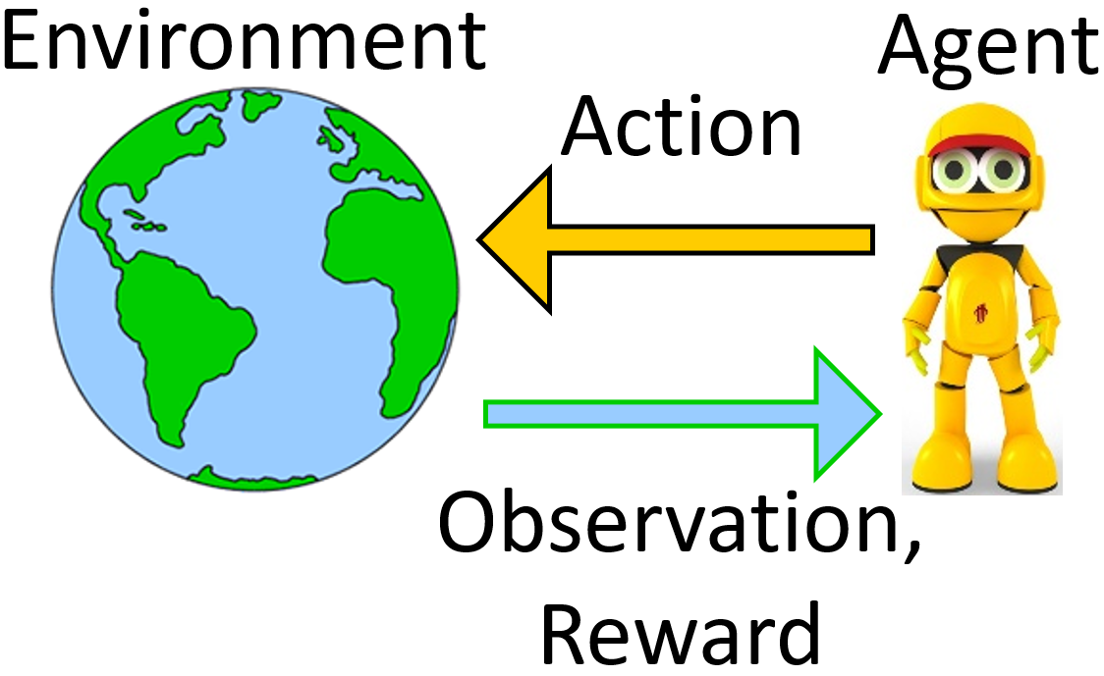
Reinforcement Learning
By observing the state of the environment, the agent takes actions for which he receives rewards. The agent’s goal is to take actions that maximize cumulative reward.

Slide 6
02
Related Work

Slide 7
Simulating an intelligent car to park in a simple parking environment
Only one available parking lot
The same start position at the beginning of each episode
Parking lots are always on one side of the parking

Slide 8
03
Problem Statement

Slide 9
Two Scenarios
One Car
Two Cars
The position of the Agents changes randomly at the beginning of each episode.
The number of available parking lots and their positions are changing in every episode randomly in a range between a minimum and a maximum number.
In every episode, the car learns to solve a different problem by facing a new model of the environment.

Slide 10
04
Prefabs

Slide 12
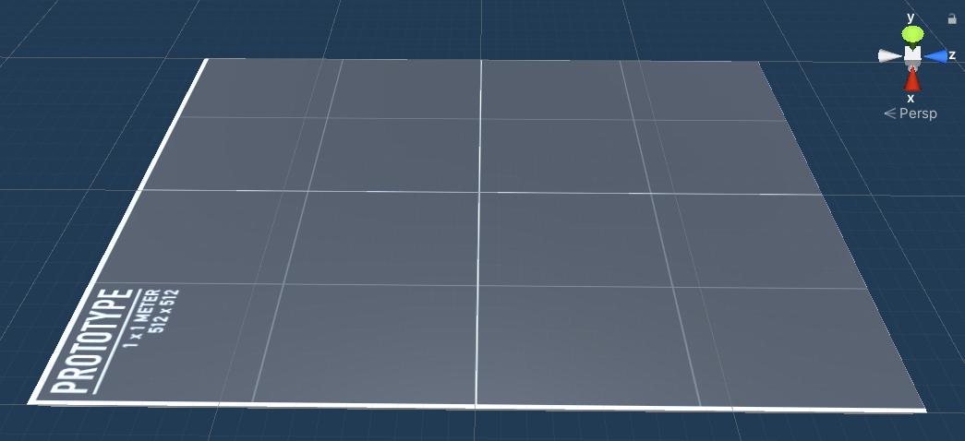
Road
Shows the ground material (grey color for the ground of the parking).
Whenever the agents park successfully, its color changes to green.
Whenever the agents have too many mistakes its color changes to red.

Slide 13
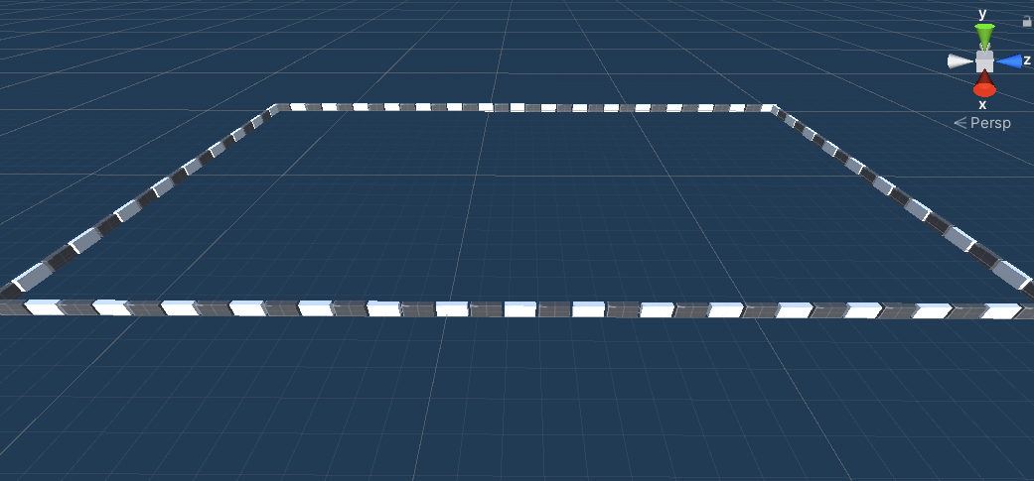
Barriers
Surrounds the parking and contains all the barrier blocks.
Each block has its box collider and "CarObstacle" script.
Whenever the agent hits one of these blocks, the "CarObstacle" script calls the "TakeAwayPoints" function of the "CarAgent" script to give a negative reward to the agent

Slide 14
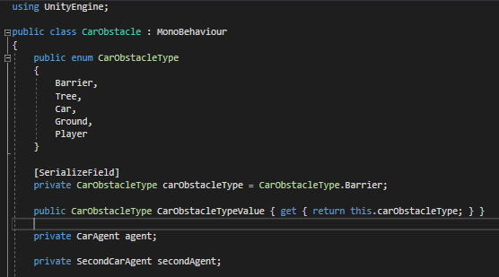
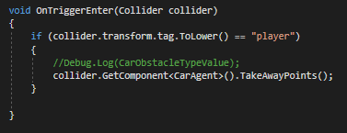
CarObstacle Script

Slide 15
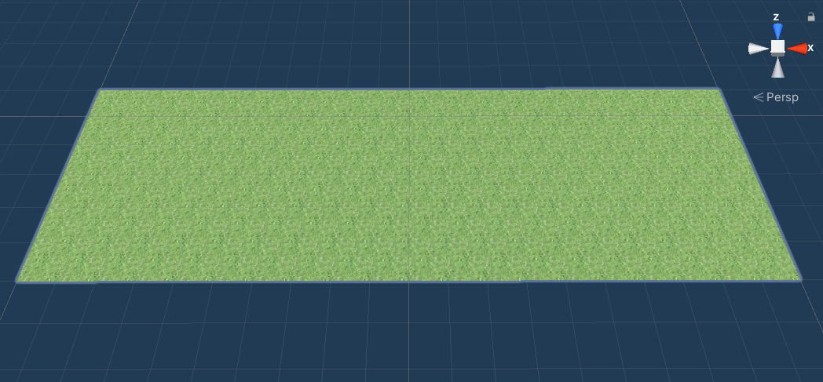
ALLGrass
Shows the grass parts in the parking.
Whenever the agent goes on the grass, the "CarObstacle" script which is added to them, calls the "TakeAwayPoints" function of the "CarAgent" script to give a negative reward to the agent.

Slide 16
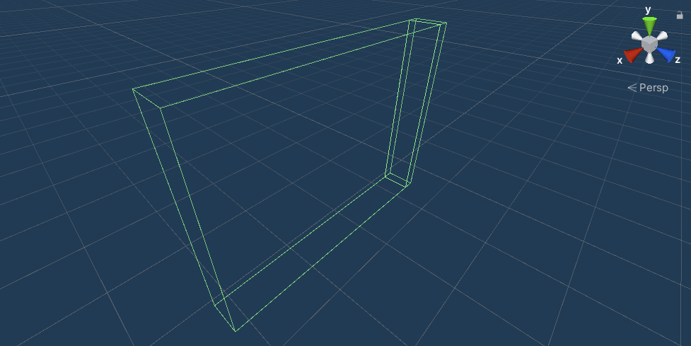
FinalGoal
Is an empty object, which has a box collider and the "CarGoal" script.
CarGoal script has an OnTriggerEnter function, that whenever an agent collides the prefab, it gives the agent a positive reward. If the rotation of the agent around the y-axis is about 90 degrees (by considering an error), the parking action of the agent becomes accepted and it will get the final reward. In the end, the CarGoal script destroys its gameobject.

Slide 17
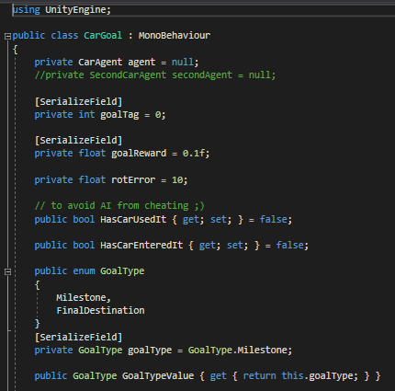
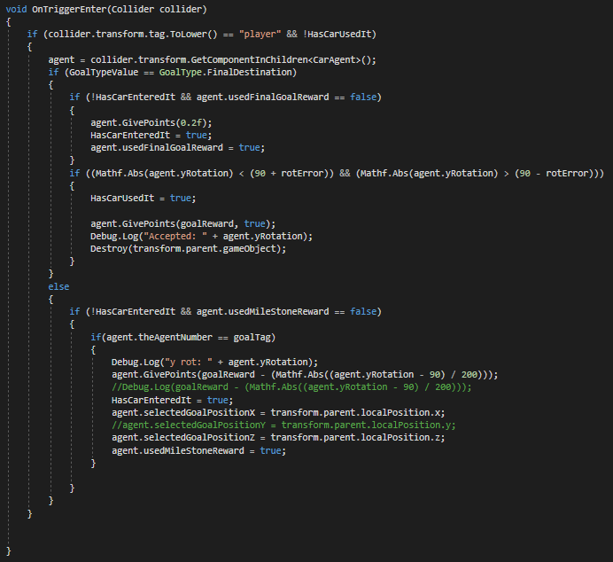
CarGoal Script

Slide 18

AgentsController
Is an empty object, which contains the "AgentsController" script.
This script has a function that is called at the beginning of each episode. This function randomizes the position of each agent at the beginning of each episode. Also, it destroys the previous goals, and then it calls the "Setup" function of the "CarSpot" script, to reset the parking spots.

Slide 19
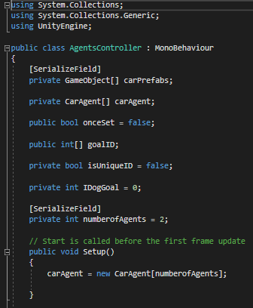
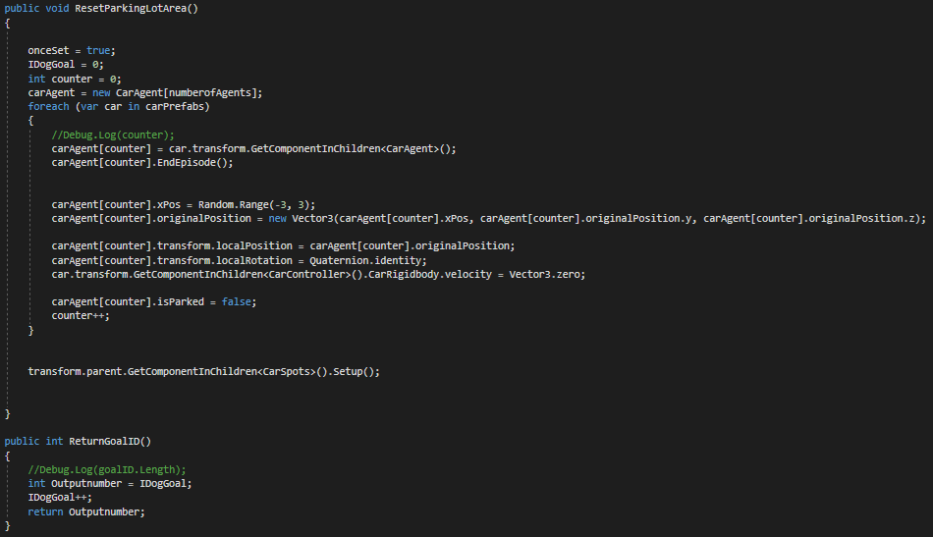
AgentsController Script

Slide 20
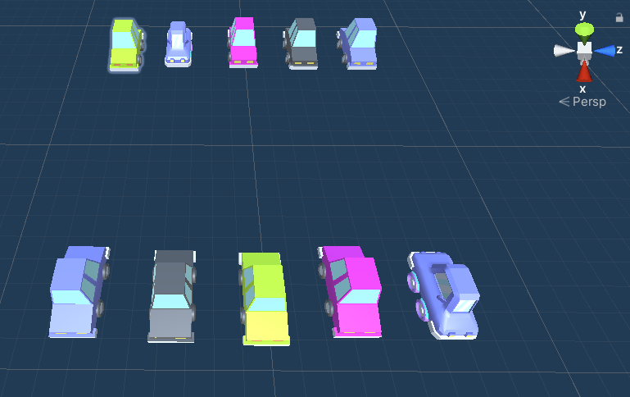
CarSpots: CarSpots
Contains all the parked cars as its children.
Whenever the "Setup" function of its script (CarSpot) is called, it chooses a random number for free parking lots. Then it chooses random places for the goals, makes the parked car of that place disable, and creates "GoalFinal" prefab instead of them.

Slide 21
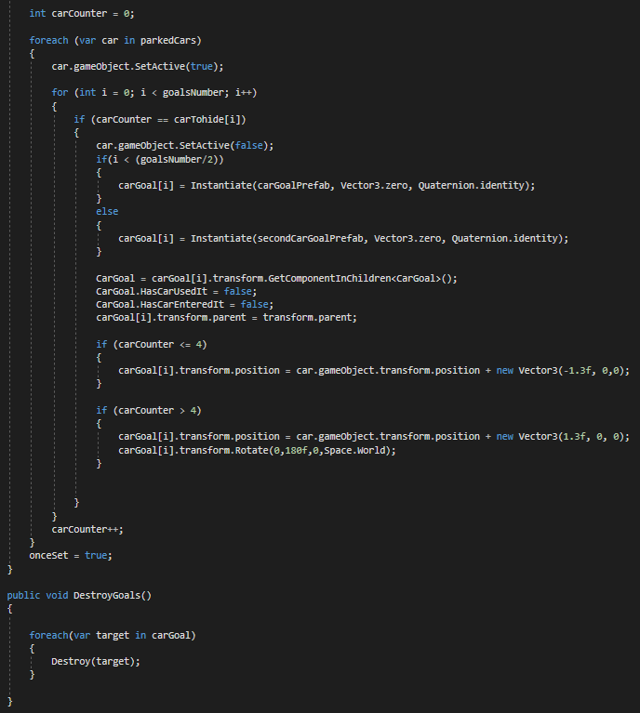
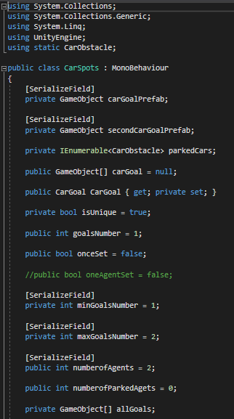
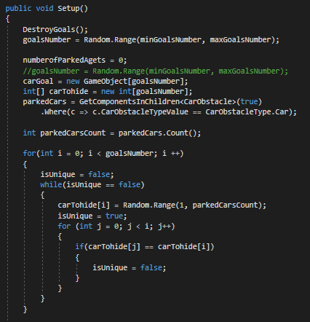
Carspots Script

Slide 22
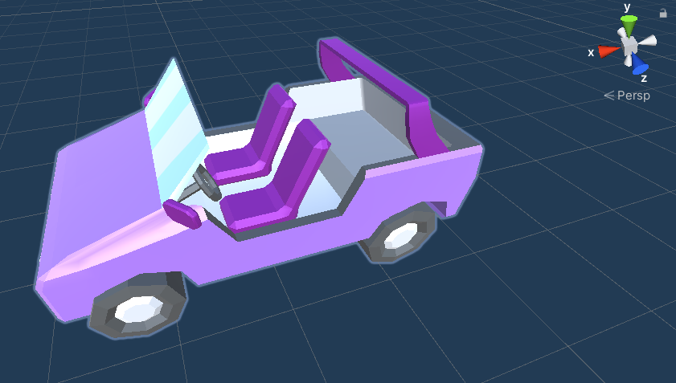
CarAgent
It has a box collider for realizing whenever it collides with other objects in the environment.
Also, it has a rigidbody component, to seem more realistic. Whenever two agents collide with each other, they will take a negative reward by OnTriggerEnter function of their CarObstacle script. This prefab also has another script named CarController. In this script, after that the agent decides the action, it applied those actions and changes the position or rotation of the agent.

Slide 23
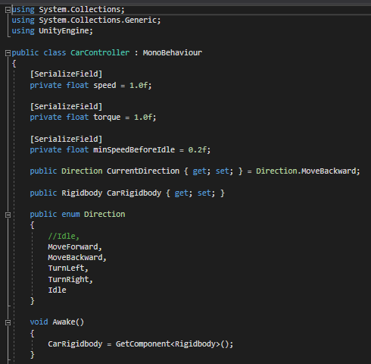
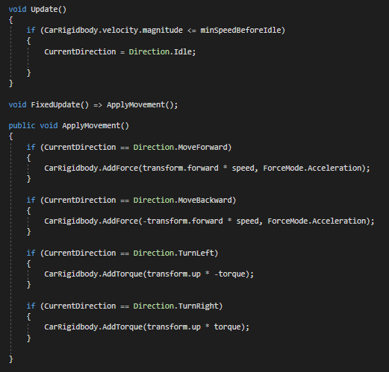
CarController Script

Slide 24
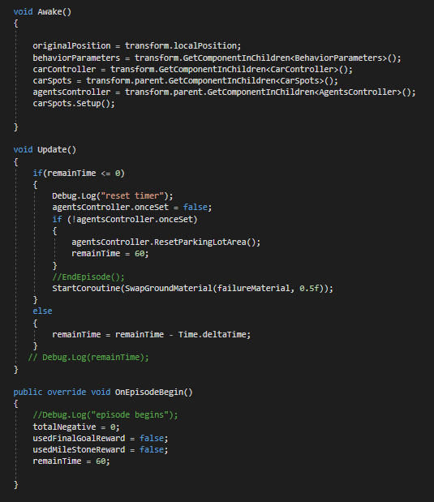
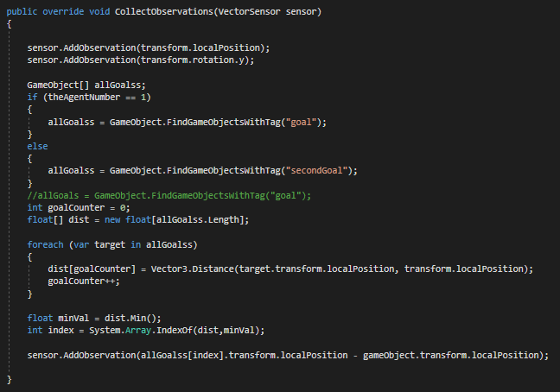
CarAgent Script

Slide 25
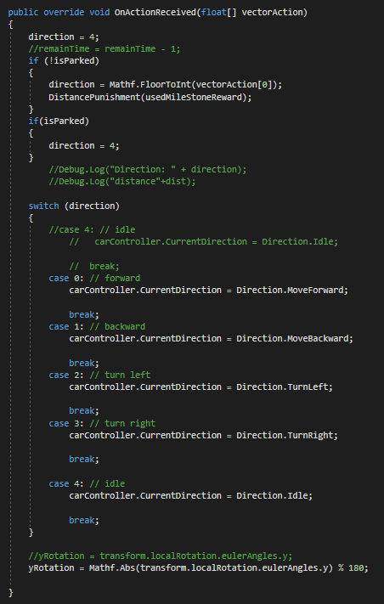
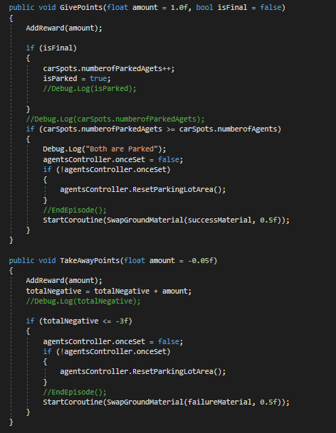
CarAgent Script

Slide 26
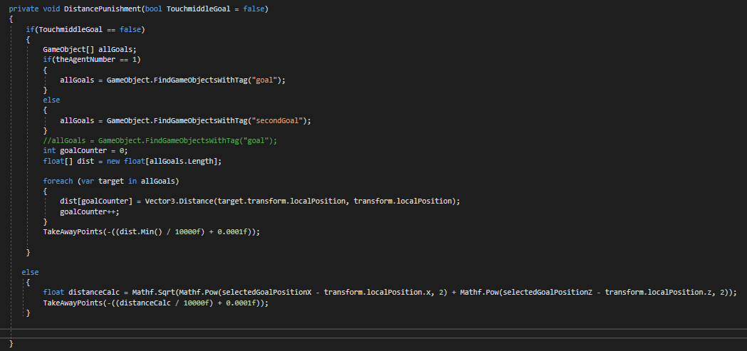
CarAgent Script

Slide 27
05
Agent Configuration

Slide 28
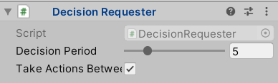
Decisions
Each time the agent requests a decision, the observation-decision-action-reward cycle repeats. Agents will request a decision by calling the Agent.RequestDecision() function. The car agent has the Decision Requester component, which able the agent to request decisions on its own at regular step intervals. In this implementation, the Decision Period parameter for all the agents is set to 5.

Slide 29
Observations and Sensors
1) Generating Observations:
The aspects of the environment which are numerical and non-visual are observed by overriding the Agent.CollectObservations() method and passing the observations to the provided VectorSensor. In this project, each of the agents has seven observations, which are the local position of the agent (3 observations), the rotation of the agent around the y-axis (1 observation), and the relative position of the nearest goal to the agent (3 observations).

Slide 30
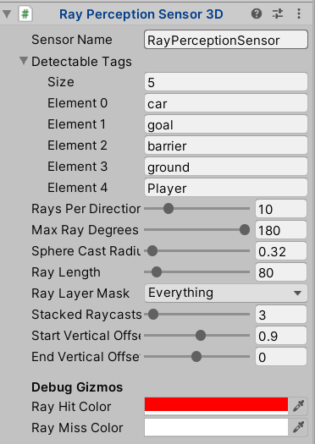
Observations and Sensors
2) Raycast Observations:
A RayPerceptionSensorComponent3D is added to each of the Agents. During observations, several are cast into the environment, and the objects that are hit determine the observation vector that is produced.

Slide 31
06
Hyperparameters

Slide 32
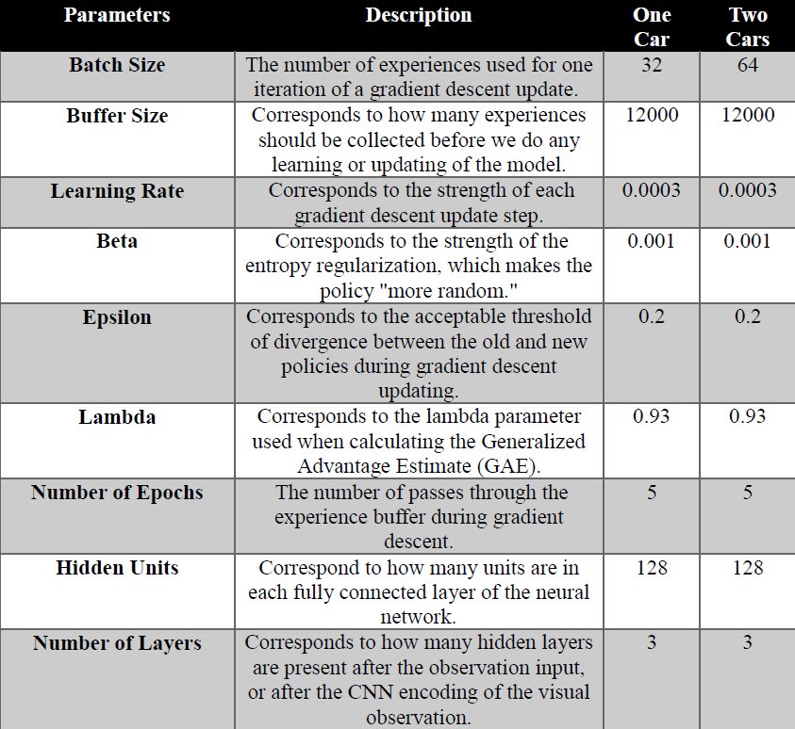

Slide 33
07
Results

Slide 34
Statistics
Cumulative Reward:
Episode Length:
The mean cumulative episode reward over all the agents with the same behavior. The general trend in reward should consistently increase over time. Small ups and downs are to be expected.
The mean length of each episode in the environment for all the agents with the same behavior.

Slide 35
One Car Scenario:
The first step for training the agent is implementing and designing the training scene. In this project, the training process is done simultaneously by nine parking environments. [Figure 7] The training took about two hours for about 1.4M steps.

Slide 36
Cumulative Reward:
Episode Length:

Slide 37
Two Cars Scenario:
The training scene of this model is completely different from the previous model. For training, the agents in this scenario are implemented in four training environments. [figure 8] In two of these environments, is trained only the first agent. In one of these environments, is trained the second agent, and in the last environment, is trained both of these agents simultaneously. The training took about eight hours. For the first car, the training is done in about 1.8M steps, and for the second car, the training is done in about 1.2M steps.

Slide 38
Cumulative Reward:
Episode Length:

Slide 39
08
Future Work

Slide 40
Many different tests and experiments have been left for the future due to lack of time (i.e. the experiments are very time consuming, requiring many hours to finish a single run). The following ideas could be tested:
It could be interesting to consider the parked cars in the parking, as agents too. So their purpose can be driving out of the parking, without crashing obstacles and other agents.
It will be interesting to increase the number of agents and see how they learn to search for an available spot without crashing each other.
It is also possible to change the parking environment during the training and see how agents learn to park in new parking environments.

Slide 41
Thank You

